Slide 1
Unit-3
Memory Management

Slide 2
Roadmap
Basic requirements of Memory Management
Memory Partitioning
Buddy System
Simple Paging and Segmentation
Need of Virtual Memory
Virtual memory Paging and Segmentation
Address translation in Paging
Address translation in Segmentation
Page Replacement Algorithms (FIFO, LRU, Optimal)
Notes:
Overview of points covered in this chapter
Point out that memory partitioning isn’t used much except for special cases such as kernel memory management

Slide 3
The need for memory management
Memory Management:-
Memory needs to be allocated to ensure a reasonable supply of ready processes to consume available processor time.
Introduce by pointing out that in a uniprogramming system, main memory is divided into two parts:
one part for the operating system (resident monitor, kernel) and
one part for the program currently being executed.
In a multiprogramming system, the “user” part of memory must be further subdivided to accommodate multiple processes.
Emphasise that memory management is vital in a multiprogramming system.
If only a few processes are in memory, then for much of the time all of the processes will be waiting for I/O and the processor will be idle.
Thus memory needs to be allocated to ensure a reasonable supply of ready processes to consume available processor time.
Notes:
Introduce by pointing out that in a uniprogramming system, main memory is divided into two parts:
one part for the operating system (resident monitor, kernel) and
one part for the program currently being executed.
In a multiprogramming system, the “user” part of memory must be further subdivided to accommodate multiple processes.
Emphasise that memory management is vital in a multiprogramming system. If only a few processes are in memory, then for much of the time all of the processes will be waiting
for I/O and the processor will be idle.
Thus memory needs to be allocated to ensure a reasonable supply of ready processes to consume available processor time.

Slide 4
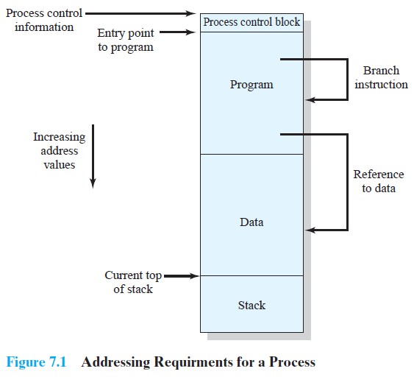
Addressing

Slide 5

(1) Relocation:-
The memory management Requirements
Following are the five requirements that memory management is intended to satisfy:-
Relocation
Protection
Sharing
Logical organisation
Physical organisation
The programmer does not know where the program will be placed in memory when it is executed,
It may be swapped to disk and return to main memory and when it is next swapped
back in, it will not place in the same main memory region as before,
But we may need to relocate the process to a different area of memory.
(relocated).
Memory references must be translated to the actual physical memory address
Notes:
The following slides expandon these topics.

Slide 6
(2) Protection:-
Processes should not be able to reference memory locations in another process without permission.
In one sense, satisfaction of the relocation requirement increases the difficulty of satisfying the protection requirement.
The location of a program in main memory is unpredictable so it is impossible to check absolute addresses at compile time.
The memory protection requirement must be satisfied by the processor
(hardware) rather than the operating system (software)
(3) Sharing
Allow several processes to access the same portion of memory.
Better to allow each process access to the same copy of the program rather than have their own separate copy.
The memory management system must therefore allow controlled access to shared areas of memory without compromising essential protection

Slide 7
(4) Logical Organization:-
Memory is organized linearly (usually)
Programs are written in modules
Modules can be written and compiled independently
Different degrees of protection given to modules (read-only, execute-only)
Share modules among processes
Segmentation helps here
(5) Physical Organization:-
Cannot leave the programmer with the responsibility to manage memory.
Memory available for a program plus its data may be insufficient.
Overlaying allows various modules to be assigned the same region of Memory but is time consuming to program.
In a multiprogramming environment, the programmer does not know
how much space will be available.
The task of moving information between the two levels of memory should
be a system responsibility.
Notes:
Main memory is usually organized as a linear, or one-dimensional, address space, consisting of a sequence of bytes or words.
Secondary memory, at its physical level, is similarly organized.
This does not correspond to the way in which programs are typically constructed. Most programs are organized into modules. If the operating system and computer hardware can effectively deal with user programs and data in the form of modules of some sort, then a number of advantages can be realized

Slide 8
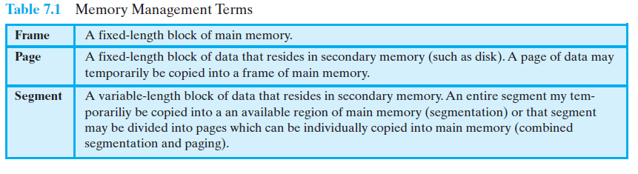
Memory management Terms

Slide 9
Roadmap
Basic requirements of Memory Management
Memory Partitioning
Buddy System
Simple Paging and Segmentation
Need of Virtual Memory
Virtual memory Paging and Segmentation
Address translation in Paging
Address translation in Segmentation
Page Replacement Algorithms (FIFO, LRU, Optimal)
Notes:
Overview of points covered in this chapter
Point out that memory partitioning isn’t used much except for special cases such as kernel memory management

Slide 10
Memory Partitioning
The principal operation of memory management is to bring processes into main memory for execution by the processor.
In almost all modern multiprogramming systems, this involves a sophisticated scheme known as virtual memory.
Virtual memory is, in turn, based on the use of one or both of two basic techniques: segmentation and paging
we must prepare the ground by looking at simpler techniques that do not involve virtual memory.
One of these techniques, is partitioning.
Two partitioning methods are available:-
Fixed Partitioning and
Dynamic Partitioning.

Slide 11
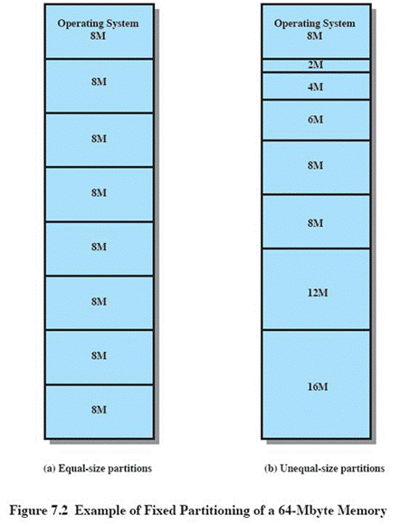
(1) Fixed Partitioning
(1) Equal-size partitions (see fig 7.3a)
The simplest scheme for managing this available memory is to partition it into regions with fixed boundaries.
Any process whose size is less than or equal to the partition size can be loaded into an available partition
If all partitions are full and no process is in the Ready or Running state, the operating system can swap a process out of any of the partitions and load in another process
Placement Algorithm Equal-size
Equal size:-
If all partitions are occupied with processes that are not ready to run, then one of these processes must be swapped out to make room for a new process.
Which one to swap out is a scheduling decision.
Process whose size is less than or equal to the partition size can be loaded into any available partition.

Slide 12
Problem with fixed equal size partitions:-
(1)
A program may not fit in a partition.
The programmer must design the program with overlays so that only a portion
of the program need be in main memory at any one time.
(2)
Main memory use is inefficient.
Any program, no matter how small, occupies an entire partition.
This results in internal fragmentation.
Internal fragmentation:-
The wasted space internal to a partition due to the fact that the block of data loaded is smaller than the partition, is referred to as internal fragmentation.

Slide 13
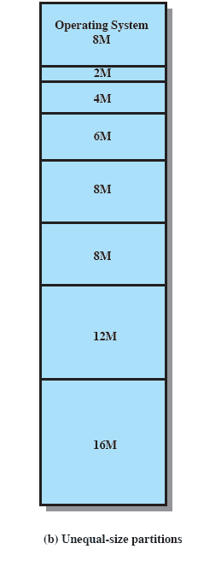
Solution – Unequal Size Partitions
Lessens both problems
but doesn’t solve completely
In Fig 7.3b,
Programs up to 16M can be accommodated without overlays
Smaller programs can be placed in smaller partitions, reducing internal fragmentation

Slide 14
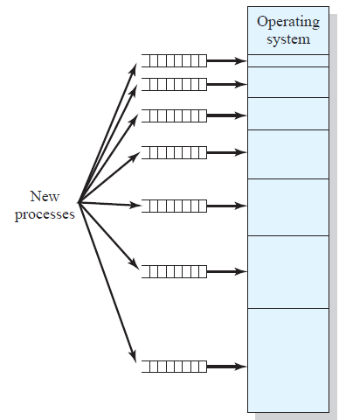
Placement Algorithm Unequal size:-
With unequal-size partitions, there are two possible ways to assign processes to partitions.
The simplest way is to assign each process to the smallest partition within which it will fit.
In this case, a scheduling queue is needed
for each partition, to hold swapped-out
processes destined for that partition (Figure 7.3a).
consider a case in which there are no
processes with a size between 12 and 16M
at a certain point in time.
In that case, the 16M partition will remain unused, even though some smaller process could have been assigned to it.

Slide 15
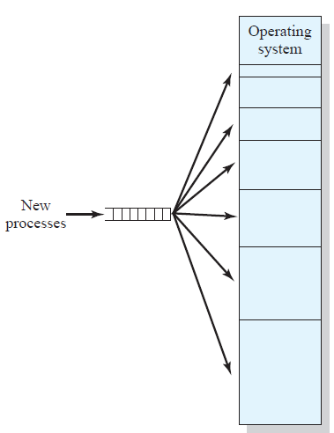
Placement Algorithm
Thus, a preferable approach would be to
employ a single queue for all processes
(Figure 7.3b).
When it is time to load a process into
main memory, the smallest available
partition that will hold the process is
selected.

Slide 16
Remaining Problems with Fixed Partitions
The number of partitions specified at system generation time limits the number of active (not suspended) processes in the system.
Because partition sizes are preset at system generation time, small jobs will not utilize partition space efficiently.
Notes:
Finish by mentioning tat fixed partitioning is almost unknown today

Slide 17
(2) Dynamic Partitioning
With dynamic partitioning, the partitions are of variable length and number.
When a process is brought into main memory, it is allocated exactly as much memory as it requires and no more.
Imagine a system with 64M RAM
Initially, main memory is empty, except for the operating system
Three processes are loaded in – leaving a ‘hole’ too small for any further process
At some point, none of the processes in memory is ready. The operating system swaps out process 2,
Which leaves sufficient room to load a new process, process 4 – but that creates another hole
Later, a point is reached at which none of the processes in main memory is ready, but process 2, in the Ready-Suspend state, is available. Because there is insufficient room in memory for process 2, the operating system swaps process 1 out and swaps process 2 back in leaving yet another hole

Slide 18
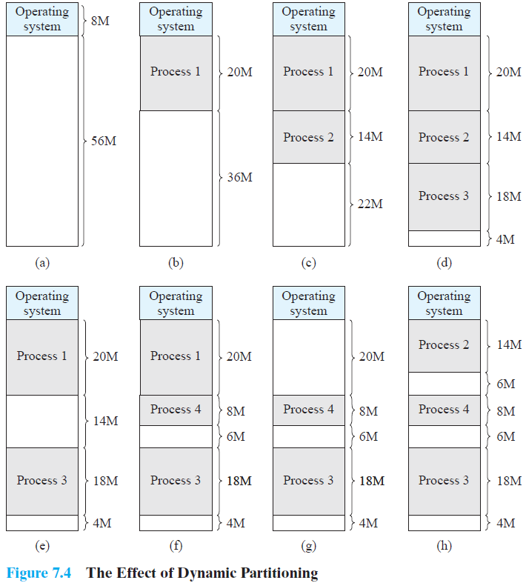

Slide 19
Dynamic Partitioning Example
OS (8M)
As time goes on, memory becomes more and more fragmented, and memory utilization declines.
Problem is:-
External Fragmentation:-
The memory that is external to all partitions becomes increasingly fragmented.
Solution to external fragmentation is
Compaction
(compaction implies the capability of dynamic relocation):-
From time to time, the operating system shifts the processes so that they are contiguous and
so that all of the free memory is together in one block.
P1
(20M)
P2
(14M)
Empty (6M)
P2
(14M)
P4(8M)
Empty (56M)
Empty (6M)
P3
(18M)
Empty (4M)
Figure 7.4
Problem :- A dynamic partitioning scheme is more complex to maintain and includes the overhead of compaction
Notes:
Animated slide
Imagine a system with 64M RAM
Initially, main memory is empty, except for the operating system
Three processes are loaded in – leaving a ‘hole’ too small for any further process
At some point, none of the processes in memory is ready. The operating system swaps out process 2,
Which leaves sufficient room to load a new process, process 4 – but that creates another hole
Later, a point is reached at which none of the processes in main memory is ready, but process 2, in the Ready-Suspend state, is available. Because there is insufficient room in memory for process 2, the operating system swaps process 1 out and swaps process 2 back in leaving yet another hole
Explain External Fragmentation and compaction – mention that compaction implies the capability of dynamic relocation

Slide 20
Placement Algorithm for Dynamic Partitioning
When it is time to load or swap a process into main memory, and if there is more than one free block of memory of sufficient size, then the operating system must decide which free block to allocate.
Three placement algorithms that might be considered are best-fit, first-fit, and
next-fit.
Best-fit algorithm
Chooses the block that is closest in size to the request
Worst performer overall
Since smallest block is found for process, the smallest amount of fragmentation is left
Memory compaction must be done more often
First-fit algorithm
Scans memory form the beginning and chooses the first available block that is large enough
Fastest
May have many process loaded in the front end of memory that must be searched over when trying to find a free block

Slide 21
Placement Algorithm
Next-fit
Scans memory from the location of the last placement
More often allocate a block of memory at the end of memory where the largest block is found
The largest block of memory is broken up into smaller blocks
Compaction is required to obtain a large block at the end of memory
Allocation
Slide shows Fig 7.5 - an example memory configuration
after a number of placement and swapping-out
operations.

Slide 22
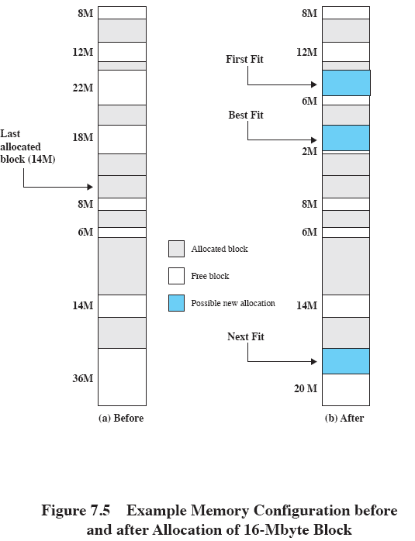
Allocation
The last block that was used was
a 22-Mbyte block from which a 14- Mbyte partition was created.
Figure 7.5b shows the difference
between the best, first, and next-fit placement algorithms in satisfying a 16-Mbyte allocation request.
Best-fit will search the entire list of available blocks and make use of the 18-Mbyte block, leaving a 2-Mbyte fragment.
First-fit results in a 6-Mbyte
fragment, and
Next-fit results in a 20-Mbyte
fragment.
Notes:
Slide shows Fig 7.5 - an example memory configuration after a number of placement and swapping-out operations.
The last block that was used was a 22-Mbyte block from which a 14-Mbyte partition was created.
Figure 7.5b shows the difference between the best, first, and next-fit placement algorithms in satisfying a 16-Mbyte allocation request.
Best-fit will search the entire list of available blocks and make use of the 18-Mbyte block, leaving a 2-Mbyte fragment.
First-fit results in a 6-Mbyte fragment, and
Next-fit results in a 20-Mbyte fragment.

Slide 23
Roadmap
Basic requirements of Memory Management
Memory Partitioning
Buddy System
Simple Paging and Segmentation
Need of Virtual Memory
Virtual memory Paging and Segmentation
Address translation in Paging
Address translation in Segmentation
Page Replacement Algorithms (FIFO, LRU, Optimal)
Notes:
Overview of points covered in this chapter
Point out that memory partitioning isn’t used much except for special cases such as kernel memory management

Slide 24
Buddy System
Both fixed and dynamic partitioning schemes have drawbacks.
A fixed partitioning scheme limits the number of active processes and may use space inefficiently if there is a poor match between available partition sizes and process sizes.
A dynamic partitioning scheme is more complex to maintain and includes the overhead of compaction.
An interesting compromise is the buddy system.
Entire space available is treated as a single block of 2^{U.}
If a request of size s such that 2^{U-1} < s<= 2^{U} is made, then the entire block is allocated.
Otherwise, the block is split into two equal buddies of size 2^{U-1}.
If 2^{U-2} < s <= 2^{U-1}, then the request is allocated to one of the two buddies.
Otherwise, one of the buddies is split in half again.
Process continues until smallest block greater than or equal to s is generated.
Notes:
In a fixed partitioning scheme limits the number of active processes and may use space inefficiently if there is a poor match between available partition sizes and process sizes.
A dynamic partitioning scheme is more complex to maintain and includes the overhead of compaction.
An interesting compromise is the buddy system.

Slide 25
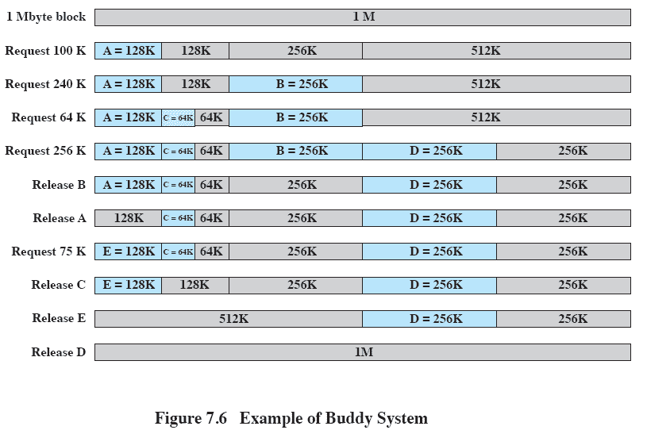
Example of Buddy System
Notes:
Figure 7.6 gives an example using a 1-Mbyte initial block.
The first request,A, is for 100 Kbytes, for which a 128K block is needed.
The initial block is divided into two 512K buddies.
The first of these is divided into two 256K buddies,
and the first of these is divided into two 128K buddies,
one of which is allocated to A.
The next request,B, requires a 256K block. Such a block is already available and is allocated.
The process continues with splitting and coalescing occurring as needed.
Note that when E is released,two 128K buddies are coalesced into a 256K block, which is immediately coalesced with its buddy

Slide 26
Example of Buddy System
Figure 7.6 gives an example using a 1-Mbyte initial block.
The first request , A , is for 100 Kbytes, for which a 128K block is needed.
The initial block is divided into two 512K buddies.
The first of these is divided into two 256K buddies,
and the first of these is divided into two 128K buddies,
one of which is allocated to A.
The next request ,B, requires a 256K block.
Such a block is already available and is allocated.
The process continues with splitting and coalescing occurring as needed.
Note that when E is released, two 128K buddies are coalesced into a 256K block, which is immediately coalesced with its buddy.

Slide 27
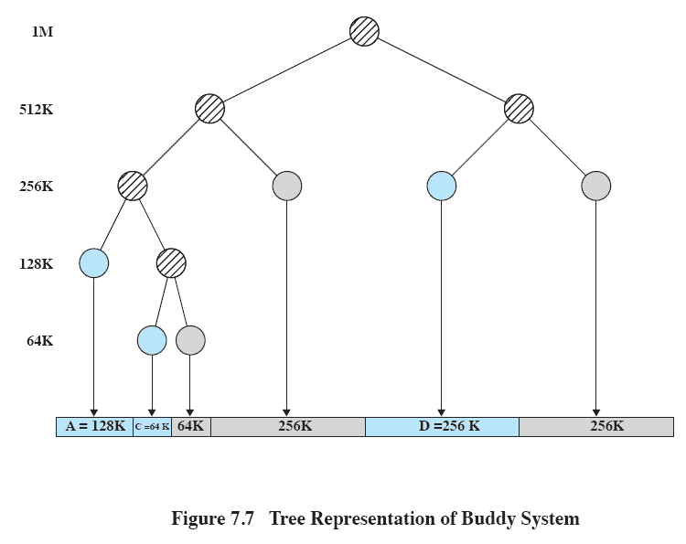
Tree Representation of Buddy System
Notes:
Figure 7.7 shows a binary tree representation of the buddy allocation immediately after the Release B request.
The leaf nodes represent the current partitioning the memory.
If two buddies are leaf nodes, then at least one must be allocated;
otherwise they would be coalesced into a larger block.
The buddy system is a reasonable compromise to overcome the disadvantages of both the fixed and variable partitioning schemes,
But in contemporary operating systems, virtual memory based on paging and segmentation is superior.
However, the buddy system has found application in parallel systems as an efficient means of allocation and release for parallel programs. A modified form of the buddy system is used for UNIX kernel memory allocation (described in Chapter 8).

Slide 28
Tree Representation of Buddy System
Figure 7.7 shows a binary tree representation of the buddy allocation immediately after the Release B request.
The leaf nodes represent the current partitioning the memory.
If two buddies are leaf nodes, then at least one must be allocated;
otherwise they would be coalesced into a larger block.
The buddy system is a reasonable compromise to overcome the disadvantages of both the fixed and variable partitioning schemes,
But in contemporary operating systems, virtual memory based on paging and segmentation is superior.
However, the buddy system has found application in parallel systems as an efficient means of allocation and release for parallel programs.

Slide 29
Roadmap
Basic requirements of Memory Management
Memory Partitioning
Buddy System
Simple Paging and Segmentation
Need of Virtual Memory
Virtual memory Paging and Segmentation
Address translation in Paging
Address translation in Segmentation
Page Replacement Algorithms (FIFO, LRU, Optimal)
Notes:
Overview of points covered in this chapter
Point out that memory partitioning isn’t used much except for special cases such as kernel memory management

Slide 30
Paging
Partition memory into small equal fixed-size chunks and The chunks of memory are called frames.
Divide each process into the same size chunks and the chunks of a process are called pages.
Operating system maintains a page table for each process
Contains the frame location for each page in the process
Memory address consist of a page number and offset within the page

Slide 31
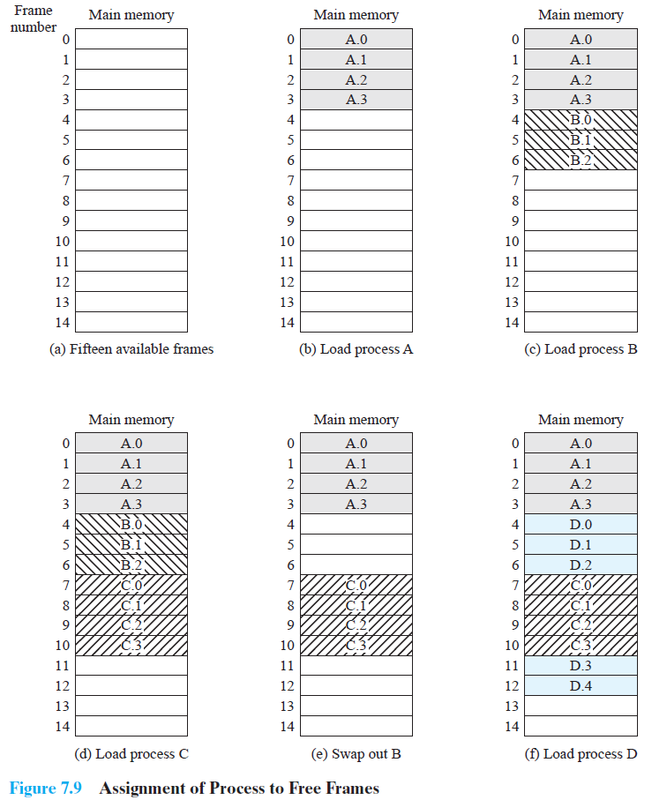

Slide 32
Paging Example
System with a number of frames allocated.
Process A, stored on disk, consists of four pages.
When it comes time to load this process, the operating system finds four free frames and loads the four pages of process A into the four frames.
3. Process B, consisting of three pages, and process C, consisting of four pages, are subsequently loaded.
4. Then process B is suspended and is swapped out of main memory.
5.Later, all of the processes in main memory are blocked, and the operating system needs to bring in a new process, process D, which consists of five pages.
The Operating System loads the pages into the available frames and updates the page table

Slide 33
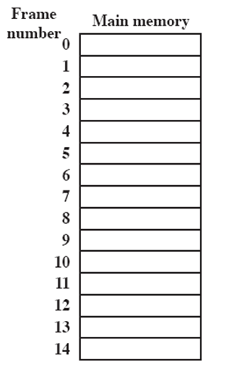
Processes and Frames
A.0
A.1
A.2
A.3
B.0
D.0
B.1
D.1
B.2
D.2
C.0
C.1
C.2
C.3
D.3
D.4
Notes:
Animated slide
System with a number of frames allocated
Process A, stored on disk, consists of four pages. When it comes time to load this process, the operating system finds four free frames and loads the four pages of process A into the four frames.
Process B, consisting of three pages, and process C, consisting of four pages, are subsequently loaded.
Then process B is suspended and is swapped out of main memory.
Later, all of the processes in main memory are blocked, and the operating system needs to bring in a new process, process D, which consists of five pages. The Operating System loads the pages into the available frames and updates the page table

Slide 34
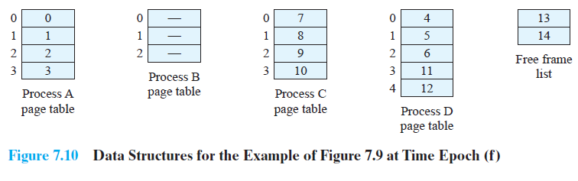
Page Table
Figure 7.10 shows the various page tables at this time.
A page table contains one entry for each page of the process, so that the table is
easily indexed by the page number (starting at page 0).
Each page table entry contains the number of the frame in main memory, if any, that
holds the corresponding page.
Operating system maintains a single free-frame list of all frames in main memory
that are currently unoccupied and available for pages.

Slide 35
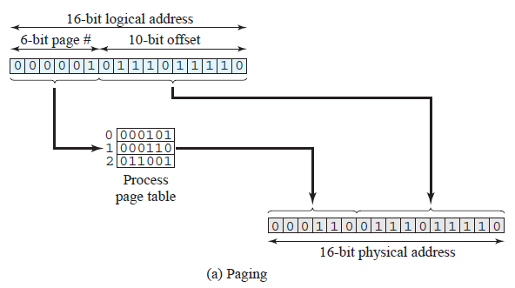
Logical to Physical Address Translation Example
In our example, we have the logical address 0000010111011110, which is page
number 1, offset 478.
Suppose that this page is residing in main memory frame 6 binary 000110.
Then the physical address is frame number 6, offset 478 =0001100111011110 (Figure 7.12a).

Slide 36
Segmentation
A user program can be subdivided using segmentation, in which the program and its associated data are divided into a number of segments.
It is not required that all segments of all programs be of the same length, although there is a maximum segment length.
As with paging, a logical address using segmentation consists of two parts, in
this case a segment number and an offset.
Segmentation is usually visible and is provided as a convenience for organizing programs and data.
The programmer or compiler will assign
programs and data to different segments.
For purposes of modular programming, the
program or data may be further broken down into multiple segments.

Slide 37
Segmentation addressing
The following steps are needed for address translation:-
Extract the segment number as the leftmost n bits of the logical address.
(2) Use the segment number as an index into the process segment table to find the starting physical address of the segment.
(3) Compare the offset, expressed in the rightmost m bits, to the length of the segment. If the offset is greater than or equal to the length, the address is invalid.
The desired physical address is the sum of the starting physical address of the segment plus the offset.

Slide 38
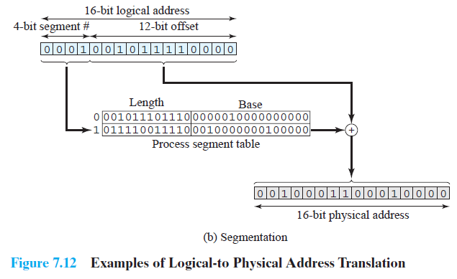
Logical to Physical Address Translation Example
In our example, we have the logical address 0001001011110000, which is segment
number 1, offset 752.
Suppose that this segment is residing in main memory starting at physical address
0010000000100000.
Then the physical address is
0010000000100000 + 001011110000 = 0010001100010000 (Figure 7.12b).

Slide 39
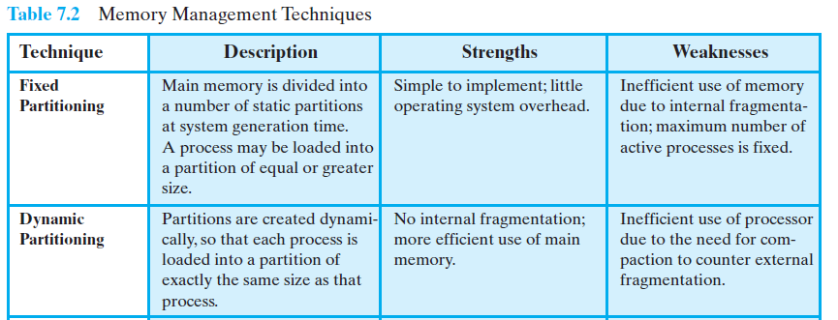

Slide 40
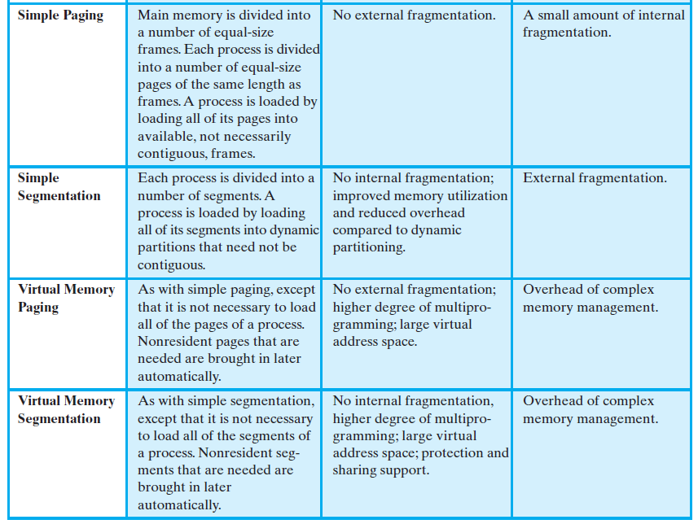

Slide 41
Roadmap
Basic requirements of Memory Management
Memory Partitioning
Buddy System
Simple Paging and Segmentation
Need of Virtual Memory
Virtual memory Paging and Segmentation
Address translation in Paging
Address translation in Segmentation
Page Replacement Algorithms (FIFO, LRU, Optimal)
Notes:
Overview of points covered in this chapter
Point out that memory partitioning isn’t used much except for special cases such as kernel memory management

Slide 42
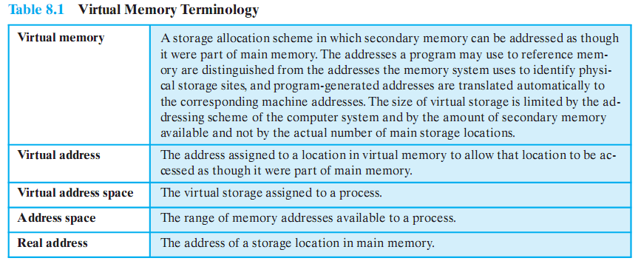

Slide 43
Execution of a Process
The portion of a process that is actually in main memory at any time is defined to be the resident set of the process.
Using the segment or page table, the processor always is able to deter mine whether page or segment is in main memory or not.
If the processor encounters a logical address that is not in main memory,
it generates an interrupt indicating a memory access fault.
The operating system puts the interrupted process in a blocking state and takes control.

Slide 44
Implications of this new strategy
There are two implications- both lead to improved system utilization:
More processes may be maintained in main memory.
Because we are only going to load some of the pieces of any particular process, there is room for more processes.
2. A process may be larger than all of main memory.
If the program being written is too large, the programmer must devise ways to structure the program into pieces that can be loaded separately in some sort of overlay strategy.
With virtual memory based on paging or segmentation, that job is left to the operating system and the hardware.
The operating system automatically loads pieces of a process into main memory as required.

Slide 45
Real and Virtual Memory
Real memory
Main memory, the actual RAM
Virtual memory
Memory on disk
Allows for effective multiprogramming and relieves the user of tight constraints of main memory
Table 8.2 summarizes characteristics of paging and segmentation, with and without the use of virtual memory.
Notes:
Refer to table 8.2 in the book for a comparison of the characteristics of paging and segmentation, with and without the use of virtual
memory.

Slide 46
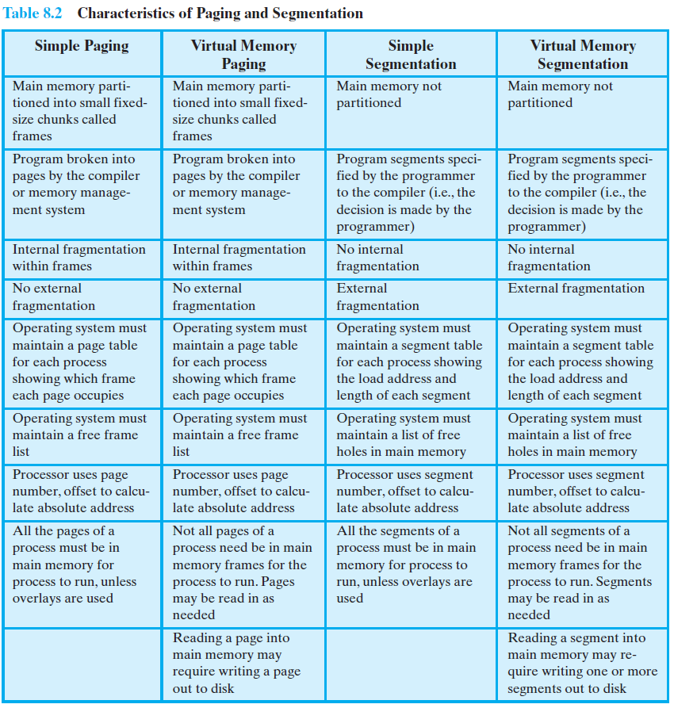

Slide 47
Thrashing
In the steady state, practically all of main memory will be occupied with process pieces, so that the processor and operating system have direct access to as many processes as possible.
Thus, when the operating system brings one piece in, it must throw another out.
If it throws out a piece just before it is used, then it will just have to go get that piece again almost immediately.
Too much of this leads to a condition known as thrashing
The system spends most of its time swapping pieces rather than executing instructions.
Thrashing is a condition in which excessive paging operations are taking place.
A system that is thrashing can be perceived as either a very slow system or one that has come to a halt.

Slide 48

Principle of Locality
Program and data references within a process tend to cluster
Only a few pieces of a process will be needed over a short period of time
Therefore it is possible to make intelligent guesses about which pieces will be needed in the future.
This suggests that virtual memory may work efficiently.
Notes:
The principle of locality states that program and data references within a process tend to cluster.
Hence, the assumption that only a few pieces of a process will be needed over a short period of time is valid.
Also, it should be possible to make intelligent guesses about which pieces of a process will be needed in the near future, which avoids
thrashing.
One way to confirm the principle of locality is to look at the performance of processes in a virtual memory environment.

Slide 49
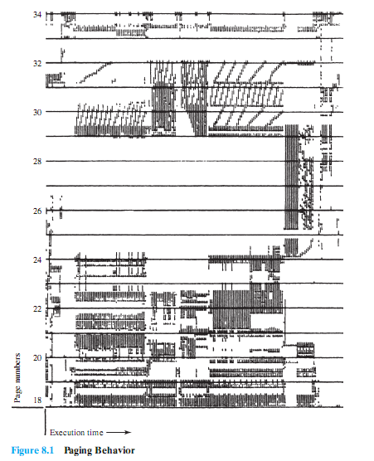
A Processes Performance in VM Environment
One way to confirm the principle of locality is to look at the performance of processes in a virtual memory environment.
Figure 8.1 is a rather famous diagram that dramatically illustrates the principle of locality.
Note that during the lifetime of the process, references are confined to a subset of pages.
Notes:
Give a brief description of this figure to the students – the detail probably not be clear in the presentation, but it is the overall clustering that is important and interesting
Figure 8.1 is a rather famous diagram that dramatically illustrates the principle of locality [HATF72].
Note that during the lifetime of the process, references are confined to a subset of pages.

Slide 50

Support Needed for Virtual Memory
For virtual memory to be practical and effective, two ingredients are needed.
There must be hardware support for the paging and/or segmentation scheme to be employed.
The operating system must include software for managing the movement of pages and/or segments between secondary memory and main memory.

Slide 51
Roadmap
Basic requirements of Memory Management
Memory Partitioning
Buddy System
Simple Paging and Segmentation
Need of Virtual Memory
Virtual memory Paging and Segmentation
Address translation in Paging
Address translation in Segmentation
Page Replacement Algorithms (FIFO, LRU, Optimal)
Notes:
Overview of points covered in this chapter
Point out that memory partitioning isn’t used much except for special cases such as kernel memory management

Slide 52
Paging
In the discussion of simple paging, we indicated that each process has its own page table.
When all of its pages are loaded into main memory, the page table for a process is created and loaded into main memory.
Each page table entry contains the frame number of the corresponding page in main memory.
A page table is also needed for a virtual memory scheme based on paging.
Again, it is typical to associate a unique page table with each process.
(Figure 8.2a – next slide).
The page table entries become more complex because only some of the pages of a process may be in main memory.

Slide 53
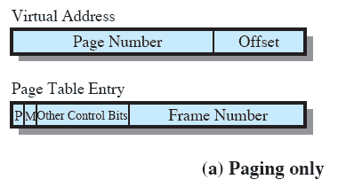
Paging Table
It is typical to associate a unique page table with each process.
A bit is needed in each page table entry to indicate whether the corresponding page is
present (P) in main memory or not , If the bit indicates that the page is in memory, then the entry also includes the frame number of that page.
The page table entry includes a modify (M) bit, indicating whether the contents of the corresponding page have been altered since the page was last loaded
Notes:
This is a repeat of the notes on the previous slide
It is typical to associate a unique page table with each process. (Figure 8.2a – this slide).
A bit is needed in each page table entry to indicate whether the corresponding page is present (P) in main memory or not.
If the bit indicates that the page is in memory, then the entry also includes the frame number of that page.
The page table entry includes a modify (M) bit, indicating whether the contents of the corresponding page have been altered since the page was last loaded

Slide 54
Segmentation
Segmentation allows the programmer to view memory as consisting of multiple address spaces or segments. Segments may be of unequal, indeed dynamic, size.
Memory references consist of a form of address (segment number, offset).
This organization has a number of advantages to the programmer over a non segmented address space:
It simplifies the handling of growing data structures.
With segmented virtual memory, the data structure can be assigned its own segment, and the operating system will expand or shrink the segment as needed.
2. It allows programs to be altered and recompiled independently, Without requiring the entire set of programs to be reloaded. Again, this is accomplished using multiple segments.
3. It lends itself to sharing among processes.
A programmer can place a utility program or a useful table of data in a segment that can be referenced by other processes.
4. It lends itself to protection.
The programmer or system administrator can assign access priviledges in a convenient fashion.

Slide 55
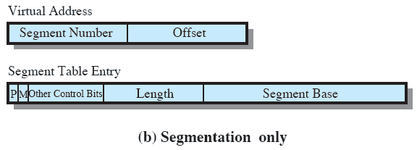
Segment Table Entries
Each segment table entry contains the starting address of the corresponding segment in main memory, as well as the length of the segment.
A P bit is needed in each segment table entry to indicate whether the corresponding segment is present in main memory or not.
If the bit indicates that the segment is in memory, then the entry also includes the starting address and length of that segment.
A modify bit indicates whether the contents of the corresponding segment have been altered.

Slide 56
Roadmap
Basic requirements of Memory Management
Memory Partitioning
Buddy System
Simple Paging and Segmentation
Need of Virtual Memory
Virtual memory Paging and Segmentation
Address translation in Paging
Address translation in Segmentation
Page Replacement Algorithms (FIFO, LRU, Optimal)
Notes:
Overview of points covered in this chapter
Point out that memory partitioning isn’t used much except for special cases such as kernel memory management

Slide 57
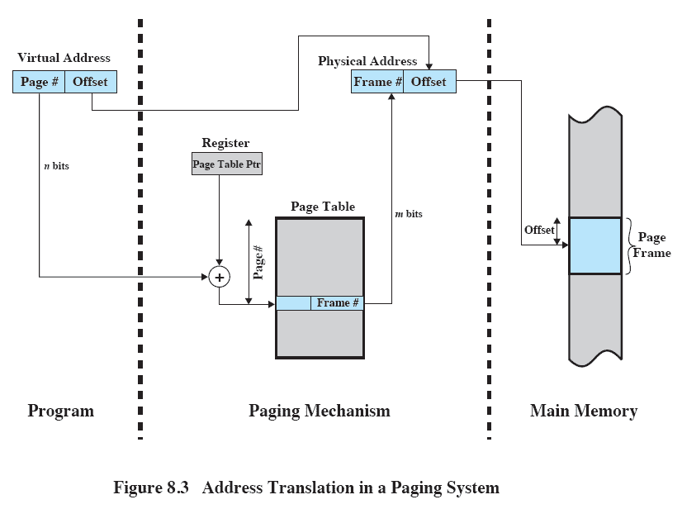
Address Translation In A Paging System
Notes:
The basic mechanism for reading a word from memory involves using a page table to translate a virtual/logical address,
consisting of page number and offset,
Into a physical address,
consisting of frame number and offset,
Because the page table is of variable length, depending on the size of the process, we cannot expect to hold it in registers.
Instead, it must be in main memory to be accessed.
Figure 8.3 suggests a hardware implementation.
When a particular process is running, a register holds the starting address of the page table for that process.
The page number of a virtual address is used to index that table and look up the corresponding frame number.
This is combined with the offset portion of the virtual address to produce the desired real address.
Typically, the page number field is longer than the frame number field (n > m).

Slide 58
Address Translation In A Paging System
The basic mechanism for reading a word from memory involves using a page table to translate a virtual/logical address,
consisting of page number and offset,
Into a physical address,
consisting of frame number and offset,
Because the page table is of variable length, depending on the size of the process, we cannot expect to hold it in registers.
Instead, it must be in main memory to be accessed.
Figure 8.3 suggests a hardware implementation.
When a particular process is running, a register holds the starting address of the page table for that process.
The page number of a virtual address is used to index that table and look up the corresponding frame number.
This is combined with the offset portion of the virtual address to produce the desired real address.
Typically, the page number field is longer than the frame number field (n > m).

Slide 59
Roadmap
Basic requirements of Memory Management
Memory Partitioning
Buddy System
Simple Paging and Segmentation
Need of Virtual Memory
Virtual memory Paging and Segmentation
Address translation in Paging
Address translation in Segmentation
Page Replacement Algorithms (FIFO, LRU, Optimal)
Notes:
Overview of points covered in this chapter
Point out that memory partitioning isn’t used much except for special cases such as kernel memory management

Slide 60
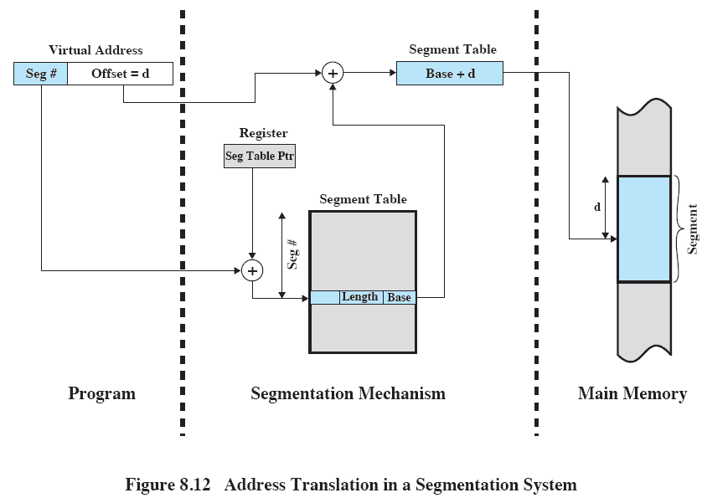
Address Translation in Segmentation
Notes:
Reading a word from memory involves the translation of a virtual, or logical, address, consisting of segment number and offset, into a physical address, using a segment table.
We cannot expect to hold the segment table in registers because it is of variable length, depending on the size of the process
Instead, it must be in main memory to be accessed.
This figure suggests a hardware implementation of this scheme (note similarity to Figure 8.3).
When a particular process is running, a register holds the starting address of the segment table for that process.
The segment number of a virtual address is used to index that table and look up the corresponding main memory address for the start of the segment.
This is added to the offset portion of the virtual address to produce the desired real address.

Slide 61
Address Translation in Segmentation
Reading a word from memory involves the translation of a virtual, or logical, address, into a physical address, using a segment table.
When a particular process is running, a register holds the starting address of the segment table for that process.
The segment number of a virtual address is used to index that table and look up the corresponding main memory address for the start of the segment.
This is added to the offset portion of the virtual address to produce the desired real address.

Slide 62
Combined Paging and Segmentation
In a combined paging/segmentation system, a user’s address space is broken up into a number of segments,
Each segment is, in turn, broken up into a number of fixed-size pages,
which are equal in length to a main memory frame.
If a segment has length less than that of a page, the segment occupies just one page.
From the programmer’s point of view, a logical address still consists of a segment number and a segment offset.
From the system’s point of view, the segment offset is viewed as a page number and page offset for a page within the specified segment.

Slide 63
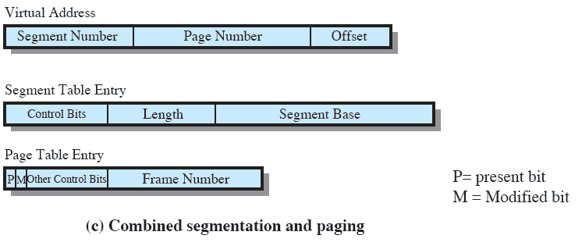
Combined Paging and Segmentation
Notes:
This figure (8.2c) suggests the segment table entry and page table entry formats.
As before, the segment table entry contains the length of the segment.
It also contains a base field, which now refers to a page table.
The present and modified bits are not needed because these matters are handled at the page level.
Other control bits may be used, for purposes of sharing and protection.
The page table entry is essentially the same as is used in a pure paging system.
Each page number is mapped into a corresponding frame number if the page is present in main memory.
The modified bit indicates whether this page needs to be written back out when the frame is allocated to another page.
There may be other control bits dealing with protection or other aspects of memory management.

Slide 64
Combined Paging and Segmentation
This figure (8.2c) suggests the segment table entry and page table entry formats.
As before, the segment table entry contains the length of the segment.
It also contains a base field, which now refers to a page table.
Other control bits may be used, for purposes of sharing and protection.
The page table entry is essentially the same as is used in a pure paging system.
Each page number is mapped into a corresponding frame number if the page is present in main memory.
The modified bit indicates whether this page is modified or not.
There may be other control bits dealing with protection or other aspects of memory management.

Slide 65
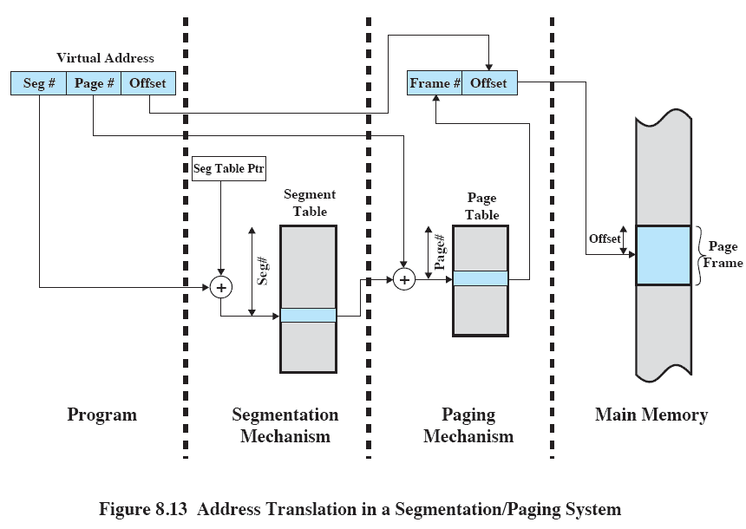
Address Translation
Notes:
This figure suggests a structure to support combined paging/segmentation (note similarity to Figure 8.5).
Associated with each process is a segment table and a number of page tables, one per process segment.
When a particular process is running, a register holds the starting address of the segment table for that process.
Presented with a virtual address, the processor uses the segment number portion to index into the process segment table to find the page table for that segment.
Then the page number portion of the virtual address is used to index the page table and look up the corresponding frame number.
This is combined with the offset portion of the virtual address to produce the desired real address.

Slide 66
Address Translation
This figure suggests a structure to support combined paging/segmentation (note similarity to Figure 8.5).
Associated with each process is a segment table and a number of page tables, one per process segment.
When a particular process is running, a register holds the starting address of the segment table for that process.
Presented with a virtual address, the processor uses the segment number portion to index into the process segment table to find the page table for that segment.
Then the page number portion of the virtual address is used to index the page table and look up the corresponding frame number.
This is combined with the offset portion of the virtual address to produce the desired real address.

Slide 67
Roadmap
Basic requirements of Memory Management
Memory Partitioning
Buddy System
Simple Paging and Segmentation
Need of Virtual Memory
Virtual memory Paging and Segmentation
Address translation in Paging
Address translation in Segmentation
Page Replacement Algorithms (FIFO, LRU, Optimal)
Notes:
Overview of points covered in this chapter
Point out that memory partitioning isn’t used much except for special cases such as kernel memory management

Slide 68
Replacement Policy
When all of the frames in main memory are occupied and it is necessary to bring in a new page to satisfy a page fault,
the replacement policy determines which page currently in memory is to be replaced.
Among the set of pages considered, which particular page should be selected for replacement
Which page is replaced?
Page removed should be the page least likely to be referenced in the near future
How is that determined?
Principal of locality again
Most policies predict the future behavior on the basis of past behavior

Slide 69
Replacement Policy: Frame Locking
One restriction on replacement policy needs to be mentioned before looking at various algorithms:
Some of the frames in main memory may be locked.
When a frame is locked, the page currently stored in that frame may not be replaced.
Much of the kernel of the operating system is held on locked frames, as well as key control structures.
In addition, I/O buffers and other time-critical areas may be locked into main memory frames.
Locking is achieved by associating a lock bit with each frame.
This bit may be kept in a frame table as well as being included in the current page table.

Slide 70
Basic Replacement Algorithms
There are certain basic algorithms that are used for the selection of a page to replace, they include
Optimal
Least recently used (LRU)
First-in-first-out (FIFO)
Clock
Examples
An example of the implementation of these policies will use a page address stream formed by executing the program is
2 3 2 1 5 2 4 5 3 2 5 2
Which means that the first page referenced is 2,
the second page referenced is 3,
And so on.

Slide 71
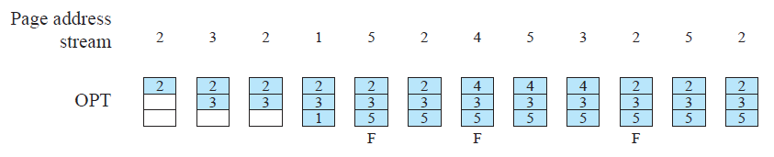
(1) Optimal policy
The optimal policy selects for replacement that page for which the time to the next reference is the longest.
This policy results in the fewest number of page faults.
BUT Clearly, this policy is impossible to implement, because it would require the operating system to have perfect knowledge of future events.
However, it does serve as a standard against which to judge real world algorithms.
2 3 2 1 5 2 4 5 3 2 5 2
The optimal policy produces three page faults

Slide 72
(2) Least Recently Used (LRU)
The least recently used (LRU) policy replaces the page in memory that has not been referenced for the longest time.
By the principle of locality, this should be the page least likely to be referenced in the near future.
And, in fact, the LRU policy does nearly as well as the optimal policy.
The problem with this approach is the difficulty in implementation.
One approach would be to tag each page with the time of its last reference;
this would have to be done at each memory reference, both instruction and data.
Even if the hardware would support such a scheme, the overhead would be tremendous.
Alternatively, one could maintain a stack of page references, again an expensive prospect.

Slide 73

LRU Example
2 3 2 1 5 2 4 5 3 2 5 2
The LRU policy does nearly as well as the optimal policy.
In this example, there are four page faults

Slide 74
(3) First-in, first-out (FIFO)
The first-in-first-out (FIFO) policy treats the page frames allocated to a process as a circular buffer, and pages are removed in round-robin style.
All that is required is a pointer that circles through the page frames of the process.
This is one of the simplest page replacement policies to implement.
The logic behind this choice is that one is replacing the page that has been in memory the longest:
A page fetched into memory a long time ago may have now fallen out of use.
This reasoning will often be wrong, because there will often be regions of program or data that are heavily used throughout the life of a program.
Those pages will be repeatedly paged in and out by the FIFO algorithm.

Slide 75
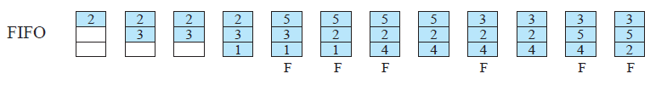
FIFO Example
2 3 2 1 5 2 4 5 3 2 5 2
Continuing our example in Figure 8.15, the FIFO policy results in six page faults.
Note that LRU recognizes that pages 2 and 5 are referenced more frequently than other pages, whereas FIFO does not.
Although the LRU policy does nearly as well as an optimal policy, it is difficult to implement and imposes significant overhead.
On the other hand, the FIFO policy is very simple to implement but performs relatively poorly.
Over the years, operating system designers have tried a number of other algorithms to approximate the performance of LRU while imposing little overhead.

Slide 76
(4) Clock Policy
The simplest form of clock policy requires the association of an additional bit with each frame, referred to as the use bit.
When a page is first loaded into a frame in memory, the use bit = 1.
Whenever the page is subsequently referenced, its use bit is set to 1.
The set of frames that are candidates for replacement is considered to be a circular buffer, with which a pointer is associated.
When a page is replaced, the pointer is set to indicate the next frame in the buffer after the one just updated.
When it comes time to replace a page, the operating system scans the buffer to find a frame with a use bit = 0.
Each time it encounters a frame with a use bit = 1, it resets that bit to zero and continues on.
If any of the frames in the buffer have a use bit of zero at the beginning of this process, the first such frame encountered is chosen for replacement.
If all of the frames have a use bit of 1, then the pointer will make one complete cycle through the buffer, setting all the use bits to zero, and stop at its original position, replacing the page in that frame.
This policy is similar to FIFO, except that, in the clock policy, any frame with a use bit of 1 is passed over by the algorithm.

Slide 77
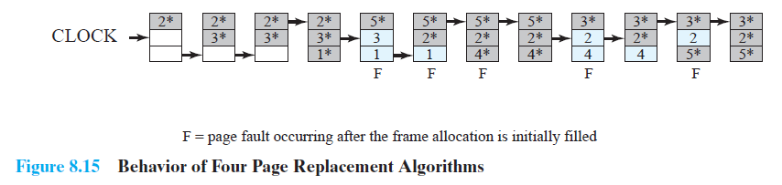
Clock Policy Example
2 3 2 1 5 2 4 5 3 2 5 2
The presence of an asterisk indicates that the corresponding use bit is equal to 1,
and the arrow indicates the current position of the pointer.
Note that the clock policy is adept at protecting frames 2 and 5 from replacement.
Notes:
The presence of an asterisk indicates that the corresponding use bit is equal to 1,
and the arrow indicates the current position of the pointer.
Note that the clock policy is adept at protecting frames 2 and 5 from replacement.

Slide 78
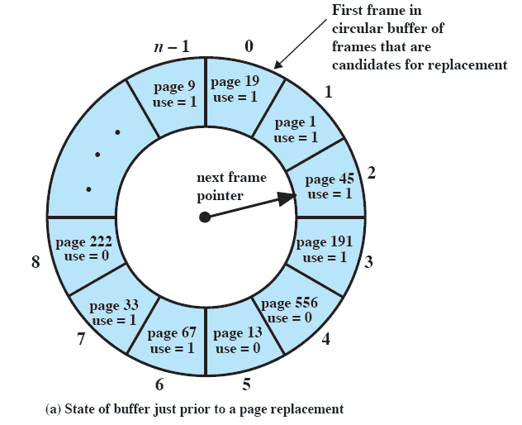
Clock Policy
Notes:
Continued on next slide
This figure (8.16) provides an example of the simple clock policy mechanism.
A circular buffer of n main memory frames is available for page replacement.
Just prior to the replacement of a page from the buffer with incoming page 727,
the next frame pointer points at frame 2, which contains page 45.
The clock policy is now executed.
Because the use bit for page 45 in frame 2 is equal to 1, this page is not replaced.
Instead, the use bit is set to zero and the pointer advances.
Similarly, page 191 in frame 3 is not replaced; its use bit is set to zero and the pointer advances.
In the next frame, frame 4, the use bit is set to 0.Therefore, page 556 is replaced with page 727.
The use bit is set to 1 for this frame and the pointer advances to frame 5, completing the page replacement procedure.

Slide 79
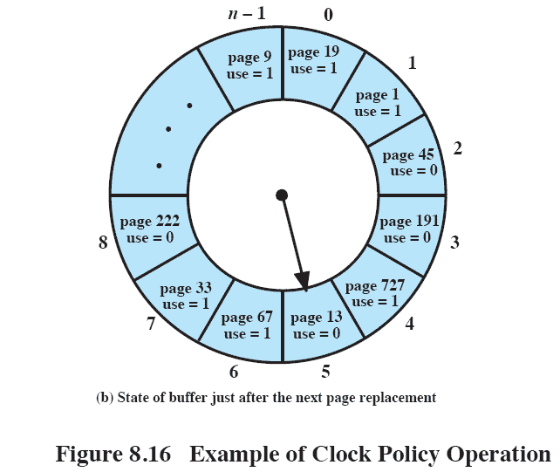
Clock Policy

Slide 80
Clock Policy
This figure (8.16) provides an example of the simple clock policy mechanism.
A circular buffer of n main memory frames is available for page replacement.
Just prior to the replacement of a page from the buffer with incoming page 727,
the next frame pointer points at frame 2, which contains page 45.
The clock policy is now executed.
Because the use bit for page 45 in frame 2 is equal to 1, this page is not replaced.
Instead, the use bit is set to zero and the pointer advances.
Similarly, page 191 in frame 3 is not replaced; its use bit is set to zero and the pointer advances.
In the next frame, frame 4, the use bit is set to 0.Therefore, page 556 is replaced with page 727.
The use bit is set to 1 for this frame and the pointer advances to frame 5, completing the page replacement procedure.

Slide 81
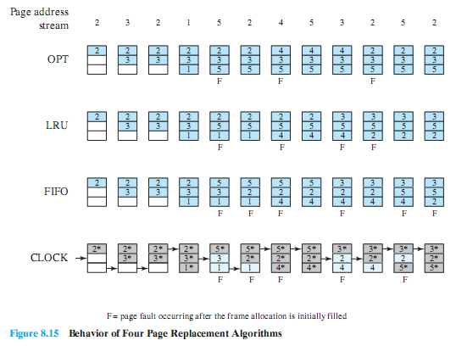
Combined Examples

Slide 82
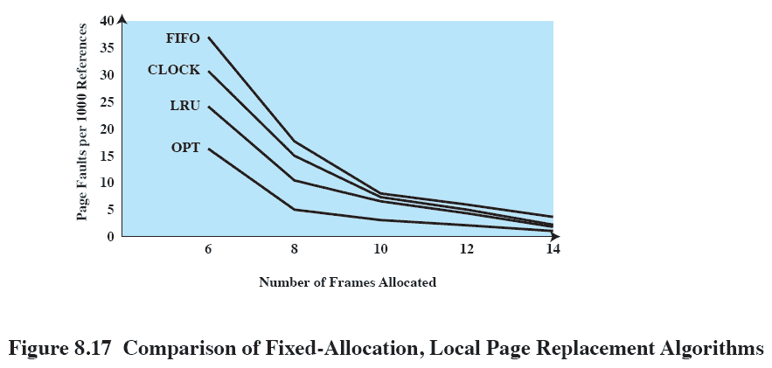
Comparison
Notes:
Figure 8.17 shows the results of an experiment reported in, which compares the four algorithms that we have been discussing;
It is assumed that the number of page frames assigned to a process is fixed.
The results are based on the execution of 0.25 x 10⁶ references in a FORTRAN program, using a page size of 256 words.
Baer ran the experiment with frame allocations of 6, 8, 10, 12, and 14 frames.
The differences among the four policies are most striking at small allocations, with FIFO being over a factor of 2 worse than optimal.
All four curves have the same shape as the idealized behavior shown in Figure 8.11b.
In order to run efficiently, we would like to be to the right of the knee of the curve (with a small page fault rate) while at the same time keeping a
small frame allocation (to the left of the knee of the curve).
These two constraints indicate that a desirable mode of operation would be at the knee of the curve.

Slide 83
Example –
Consider the page references 7, 0, 1, 2, 0, 3, 0, 4, 2, 3, 0, 3, 2, 3 with 4 page frame. Find number of page fault.
OPT – 2 page faults
LRU -2
FIFO – 3
6, 7, 8, 9, 6, 7, 1, 6, 7, 8, 9, 1
FRAMES -3
OPT – 4
LRU – 9
FIFO - 6

